Slide 1

Heat and Thermodynamics
Dr. Md. Anisur Rahman
Assistant Professor (Physics)
University of Asia Pacific
Dhaka, Bangladesh

Slide 2
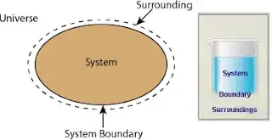
Thermodynamic system and its type
Thermodynamic systems are “regions in space whose thermodynamic properties are of interest“. It is the part of the universe that is separated from the surrounding by real or hypothetical boundaries. The surrounding contains everything other than the system, including other thermodynamic systems, as shown in the figure below. In simple terms:
Universe = System + Surrounding

Slide 3
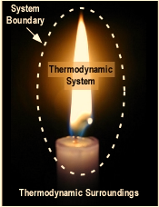
Systems–A thermodynamic system is defined as any material consisting of an extremely large number of atoms or molecules, constituting a solid, liquid or gaseous state chosen separately from the rest of the universe, enclosed by boundary surface.
Boundary–The system and surrounding are separated by boundary. It may be fixed or movable or imaginary. It does not contain any volume or mass in space.
Surroundings–Anything outside the system which affects the behavior of the system is known as surrounding.

Slide 4
Types of walls of a System:-
(i) Diathermal Walls - These wall permits the transmission of heat through them into or out of the system.
(ii) Adiabatic Walls - These walls does not permit any heat to enter into the system or to come out of the system.

Slide 5
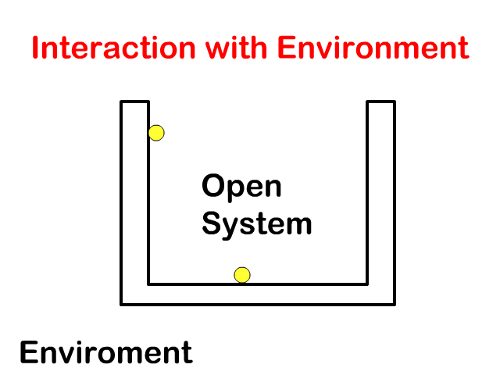
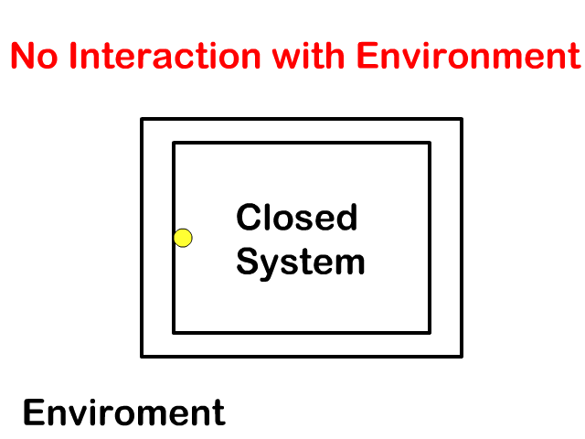
Classification of Thermodynamic Systems: Open, Closed, Isolated Systems
Open System: Such a system, in which the exchange of both energy and matter is possible between the system and surroundings.
Closed System. Such a system, in which energy is exchanged with the surroundings, but no matter is allowed to transfer across the boundaries.
Isolated System. Such a system, which is totally enclosed by an adiabatic walls and no energy exchange is possible with the surroundings. There is also no transfer of matter across the boundaries.

Slide 6
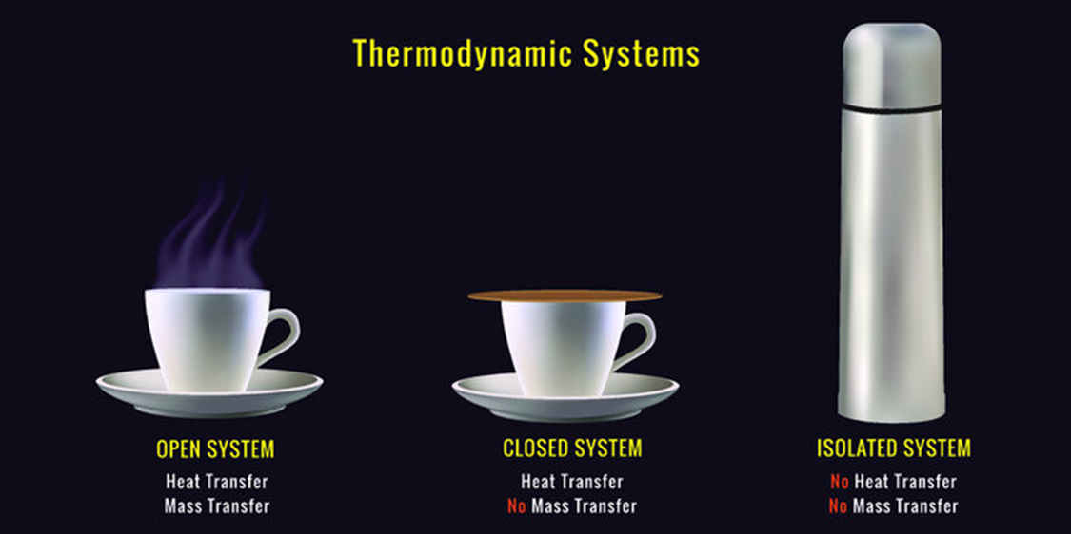

Slide 7
Thermodynamic Equilibrium
The state of a system is determined by variables of the system, such as pressure, temperature, volume and composition. If the variables change, the system also changes in its state. However on the other hand, if a complete uniformity in the magnitudes of the variables is required, a steady condition is obtained and the system is said to have attained equilibrium. For attaining complete equilibrium, there should be chemical, mechanical and thermal stability.
Chemical Equilibrium. When the composition of the system remains fixed and definite, the system is said to be in chemical equilibrium.
Mechanical Equilibrium. When there is no unbalanced force is existing between the system and surroundings, the system is said to in mechanical equilibrium.
Thermal Equilibrium. If the temperature is same throughout the system and identical with that of the surroundings, the system is said to be in thermal equilibrium.
Thermodynamic Equilibrium. A system which is in chemical, mechanical and thermal equilibrium is said to be in thermodynamic equilibrium.

Slide 8
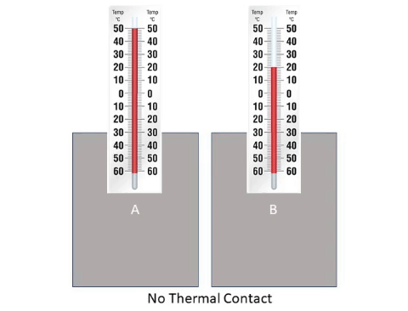
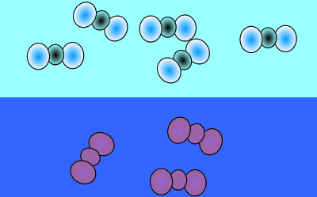
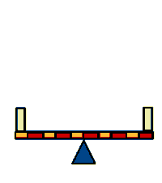
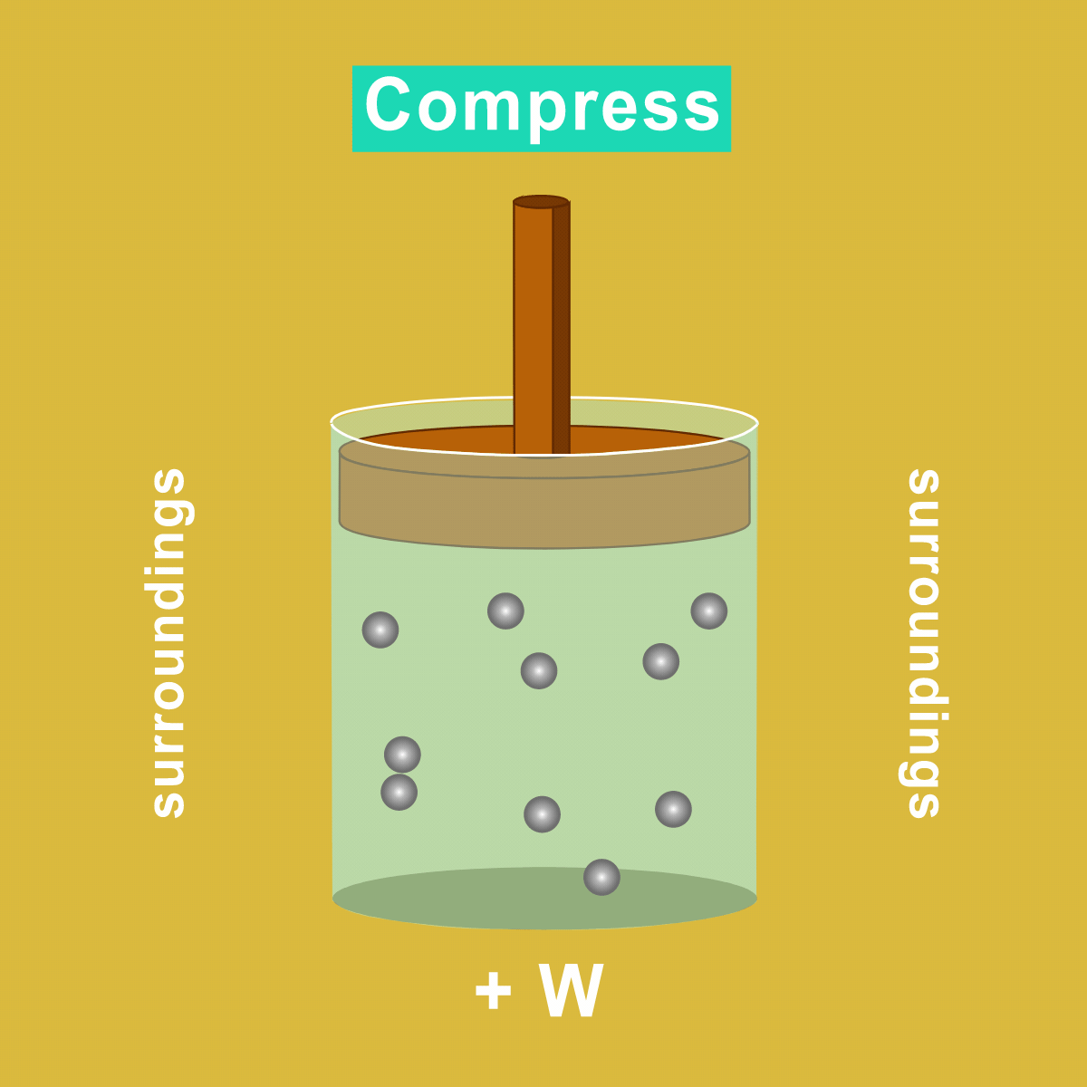
Thermal equilibrium
chemistry - greenhouse-carbon and carbonates-equilibria.
Mechanical equilibrium

Slide 9
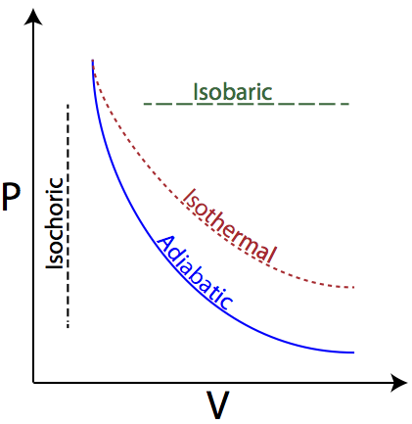
Isochoric process: The process, in which changes in pressure and temperature take place in such a way that the volume of the system remains constant, is called isochoric process.
Isobaric process: The process in which change in volume and temperature of a gas take place at a constant pressure is called an isobaric process.
Isothermal process: The process in which change in pressure and volume takes place at a constant temperature, is called an isothermal change.
Adiabatic process: The process in which change in pressure and volume and temperature takes place without any heat entering or leaving the system is called adiabatic change.

Slide 10
State function: Mass, pressure, density, energy, temperature, volume, enthalpy, entropy, Gibbs free energy and chemical composition are all examples of state functions in thermochemistry.
Path function: Heat and work are the path functions. Path function means a quantity that only depends on the path but not on initial and final States.
Internal Energy: The internal energy is a state function of a system and its value depends only on the current state of the system. From a non-relativistic microscopic point of view, the internal energy is the sum of the microscopic kinetic and potential energies of the system. The microscopic potential energy, U_{micro pot}, is associated with the forces, including the chemical bonds, between the particles and the microscopic kinetic energy, U_{micro kin}, is due to the motion of the system's particles (like translation, rotations, vibrations).
The internal energy arises from the random or disorganized motion of molecules in the system, as shown in Figure.

Slide 11
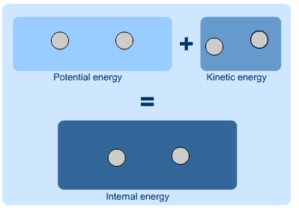
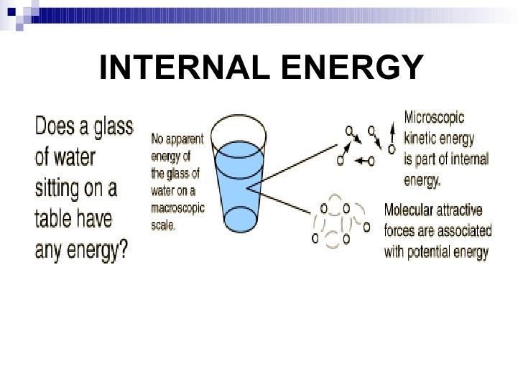
Internal Energy
Microscopic
kinetic energy
is part of internal energy.
No apparent
energy of the
the glass of
water on a macroscopic
scale
Molecular attractive
forces are associated
with potential energy.

Slide 12
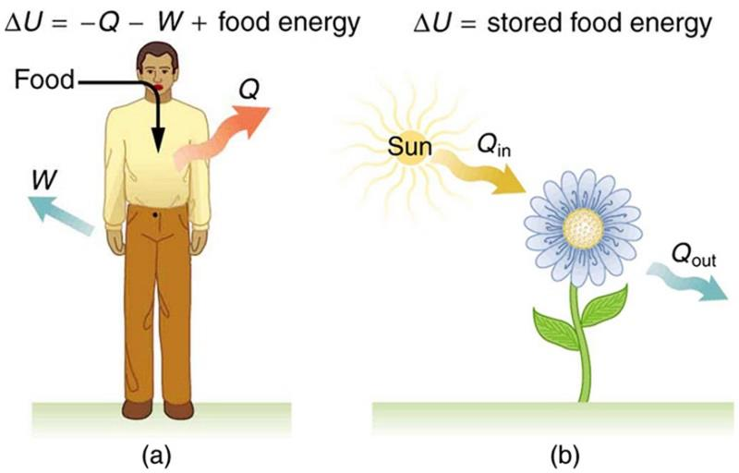
Application of First law of Thermodynamics in our daily life
Light bulbs transform electrical energy into light energy (radiant energy)
Plants convert the solar energy into chemical energy stored in organic molecules

Slide 13
First law of thermodynamics
In thermodynamics, the first law of thermodynamics is an expression of the law of the conservation of energy. The first law of thermodynamics states:
The amount of heat given to a system is equal to the sum of the increase in the internal energy of the system and the external work done.
The first law can be stated mathematically as:
where dU is a small increase in the internal energy of the system, δH is a small amount of heat added to the system, and δW is a small amount of work done by the system.

Slide 14
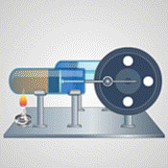
First law of thermodynamics

Slide 15
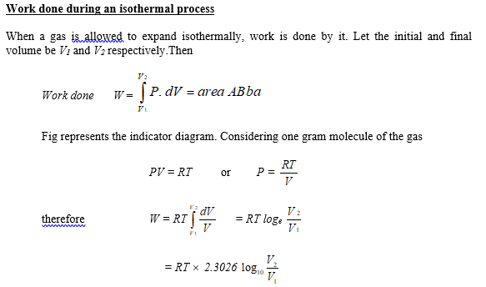

Slide 16
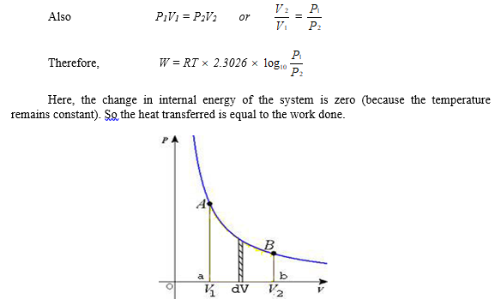

Slide 17
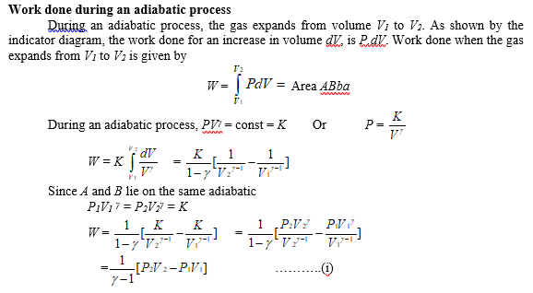
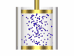

Slide 18
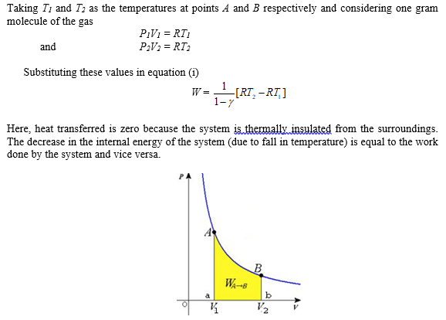

Slide 19
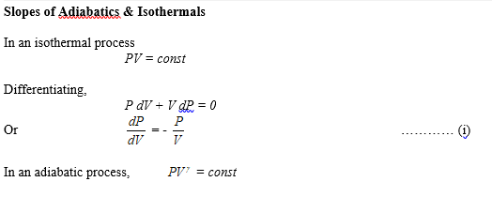

Slide 20
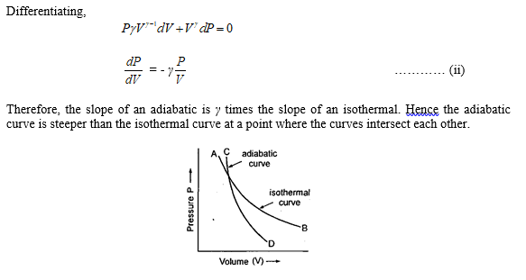

Slide 21
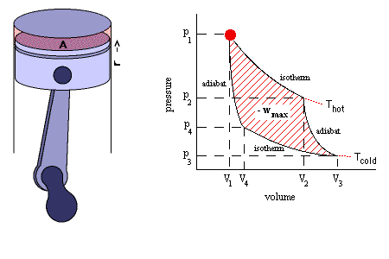
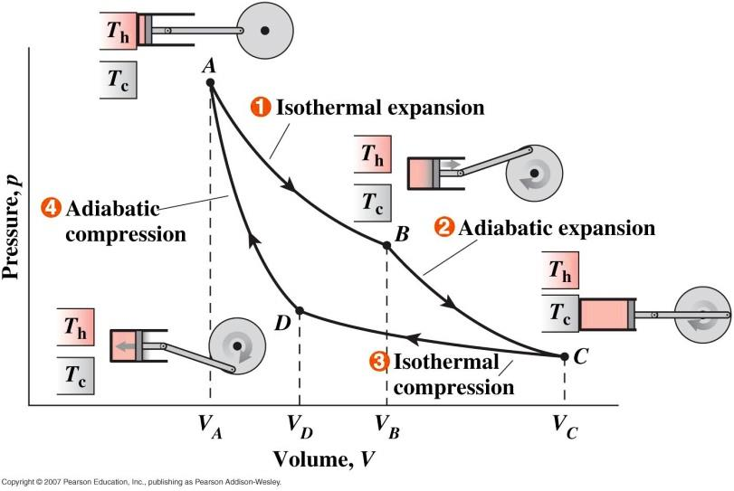
Isentropic Process
Then the efficiency of this cycle is given by
It is a reversible adiabatic process which occurs at constant entropy. The animation shows a complete Carnot cycle in which isentropic process occurs.

Slide 22


